Slide 1

PyHC 2024 Summer School Wrap Up
Julie Barnum
LASP/University of Colorado Boulder PyHC 2024 Summer School, 24 May 2024

Slide 2

Notes of Gratitude
A HUGE thanks to…
LASP for hosting us here in Boulder, CO,
NASA for funding the PyHC leadership team and travel for in-person presenters,
NSF for funding travel for several summer school attendees,
Leah Park (LASP) for all her administrative assistance (badges, parking, room scheduling, etc.),
Facilities for setting up the room,
LASP SPSC front desk for signage and general help,
LASP IT for setting up and handling AV,
All our presenters for their hard work in preparing this week's materials,
The org committee for all their (our) hard work in putting this all together,
Those who contributed to the PyHC Challenger Ladder prizes,
and, all the attendees for making the trip out here (and coming online)/taking time out of their busy schedules to attend, for the excellent questions, and generally for participating in our summer school!

Slide 3
Saving HelioCloud Content
To save everything as a local copy to your machine…
In HelioCloud, go to New Launcher -> Terminal, which creates a linux terminal
Zip all the files there with “zip myfiles.zip -r summer-school/” (where ‘myfiles.zip’ is whatever you want to name your archive)
Once that finishes (it takes a while; lots of data there) you can go back to the HelioCloud file browser (right side) and in your home directory is ‘myfiles.zip’. Select it and right-click to Download to your local machine.
Once you’re home, unpack and you can continue working with them (install Jupyter etc to use locally)
Make sure to save your work on HelioCloud by next Wednesday, June 3rd EOD (EDT)
You can also get at all the notebooks/content from the summer-school GitHub repository
https://github.com/heliophysicsPy/summer-school-24

Slide 4
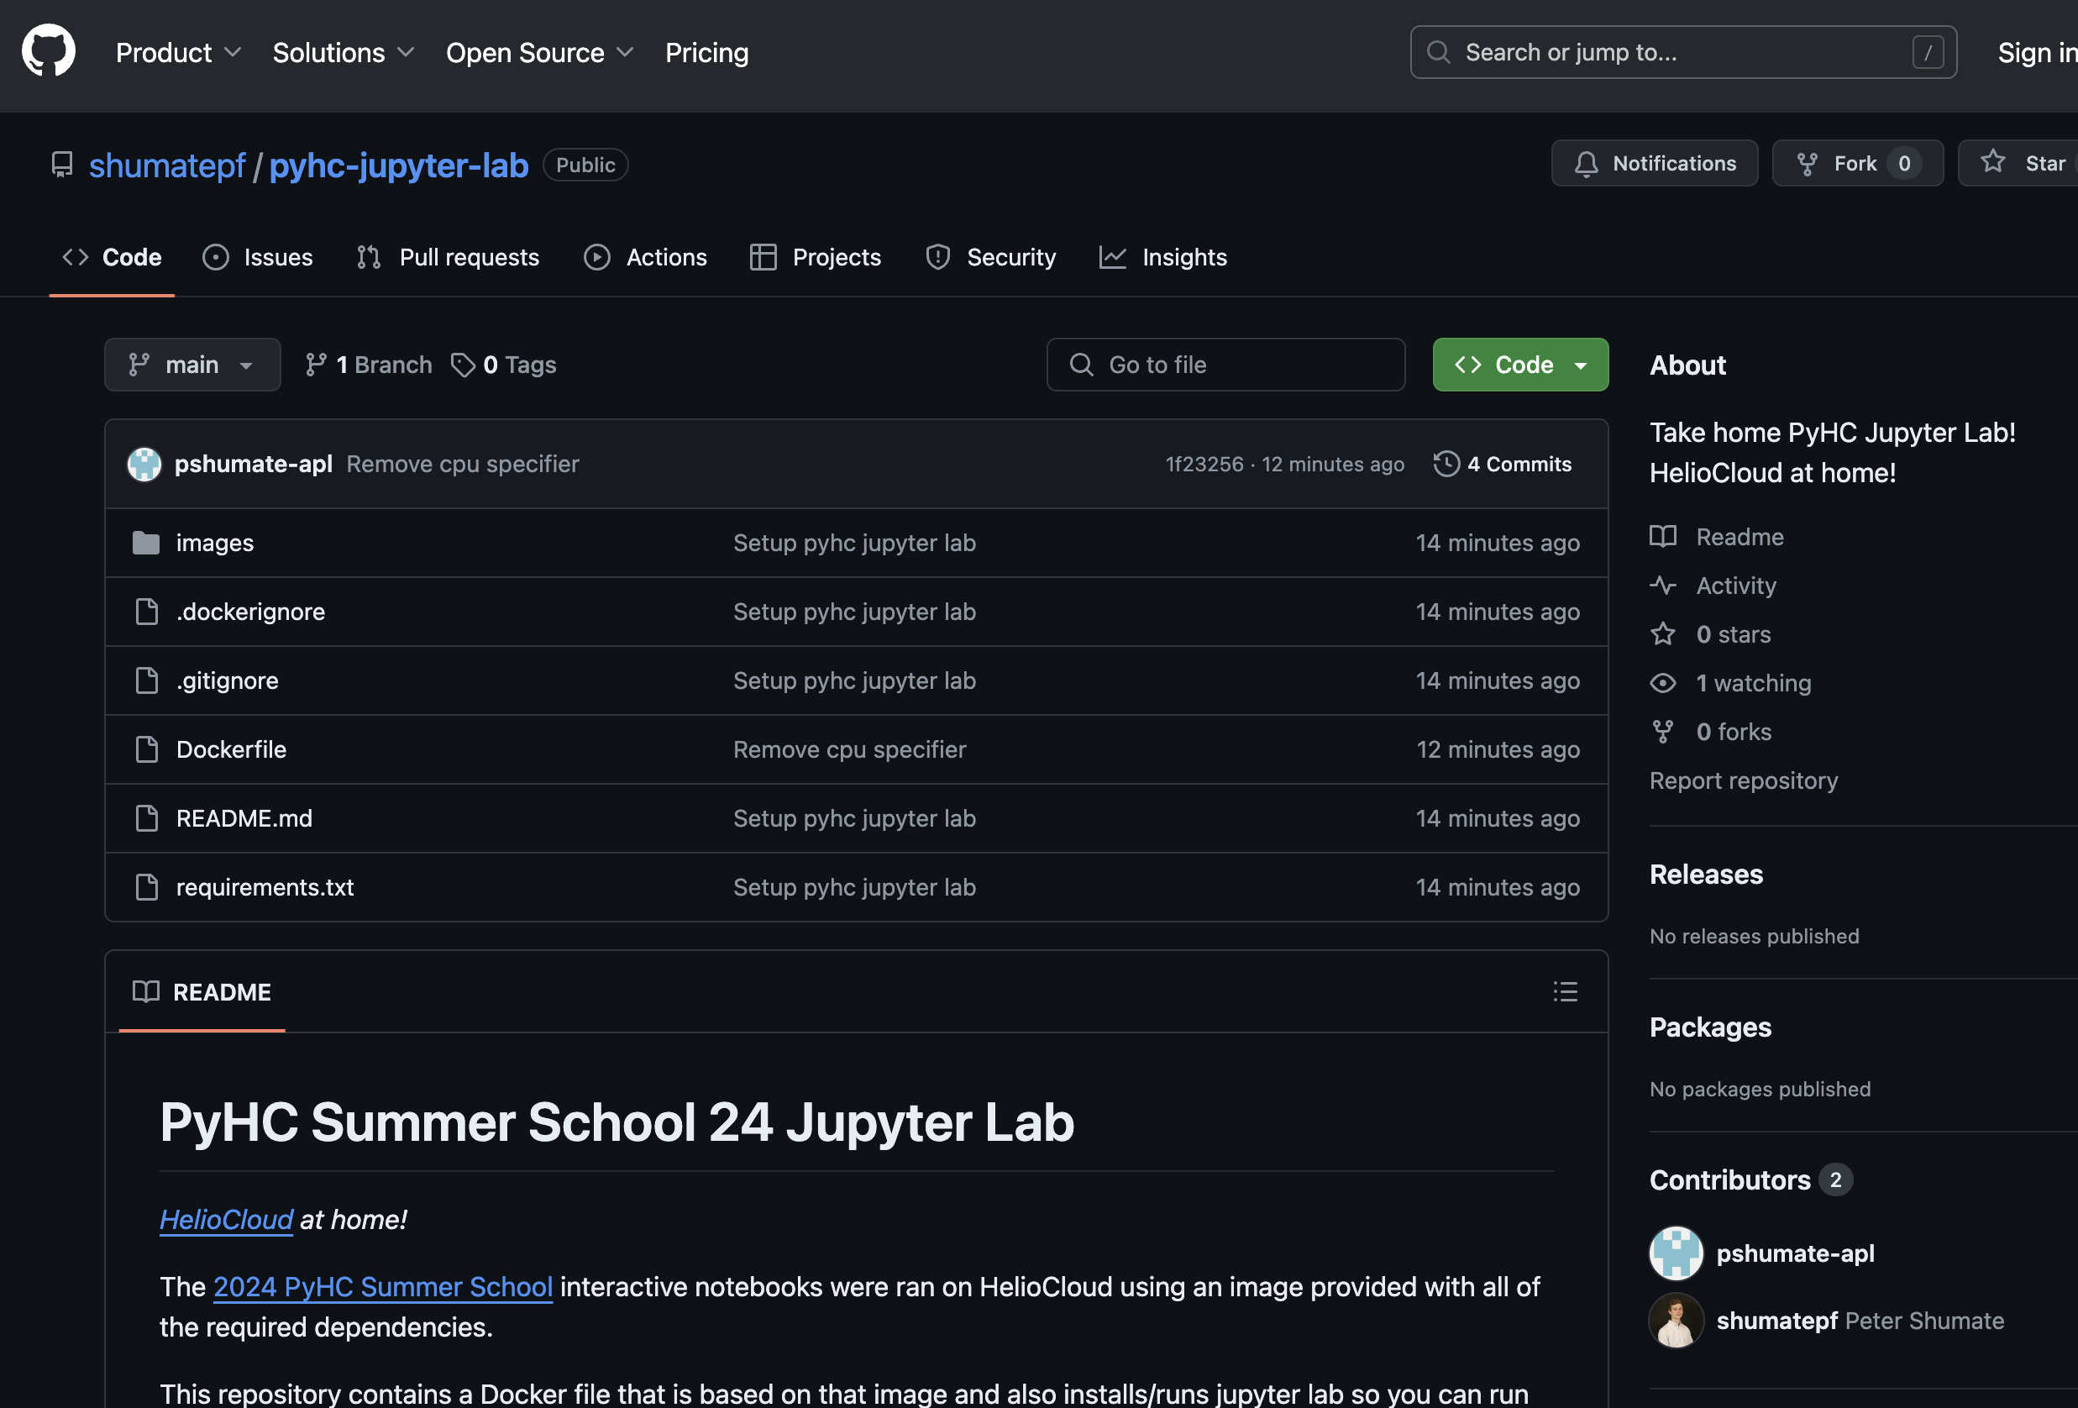
HelioCloud… at home?!
Available via GitHub: https://github.com/shumatepf/pyhc-jupyter-lab
Dockerized PyHC environment used during this summer school
Installs/runs jupyter lab so you can run the same notebooks without access to HelioCloud!

Slide 5
Other Notes
We’d greatly appreciate getting all attendees feedback on this Summer School!
https://tinyurl.com/pyhc-school-feedback
Please fill that out no later than Friday, May 31st EOD (MDT)
If you presented a poster at this summer school, submit it to our Zenodo collection for long-term archival
https://zenodo.org/communities/pyhc-school-24
This also gets you a DOI to CITE YOUR WORK
We will not immediately be closing down the Slack Space, but will eventually clear it out so the next summer school can start fresh
Want to re-watch Summer School content?
See the Summer School playlist on the PyHC YouTube channel: https://tinyurl.com/pyhc-school-youtube

Slide 6
Connecting After Summer School
Questions regarding project presentations/tutorials?
Asking PyHC devs to be checking summer school slack once a day for the week week (minus federal holidays), feel free to post questions there.
After that, will need to contact devs via email/their own discussion channels
We’ll email out those contact points via the summer school email list.
Want to connect with PyHC after the Summer School?
We have a mailing list you can get on, a Slack space (ping me on the summer school slack, or via email), a group on Helionauts, as well as a Twitter account!
Find all this on the contact page: https://heliopython.org/contact/

Slide 7
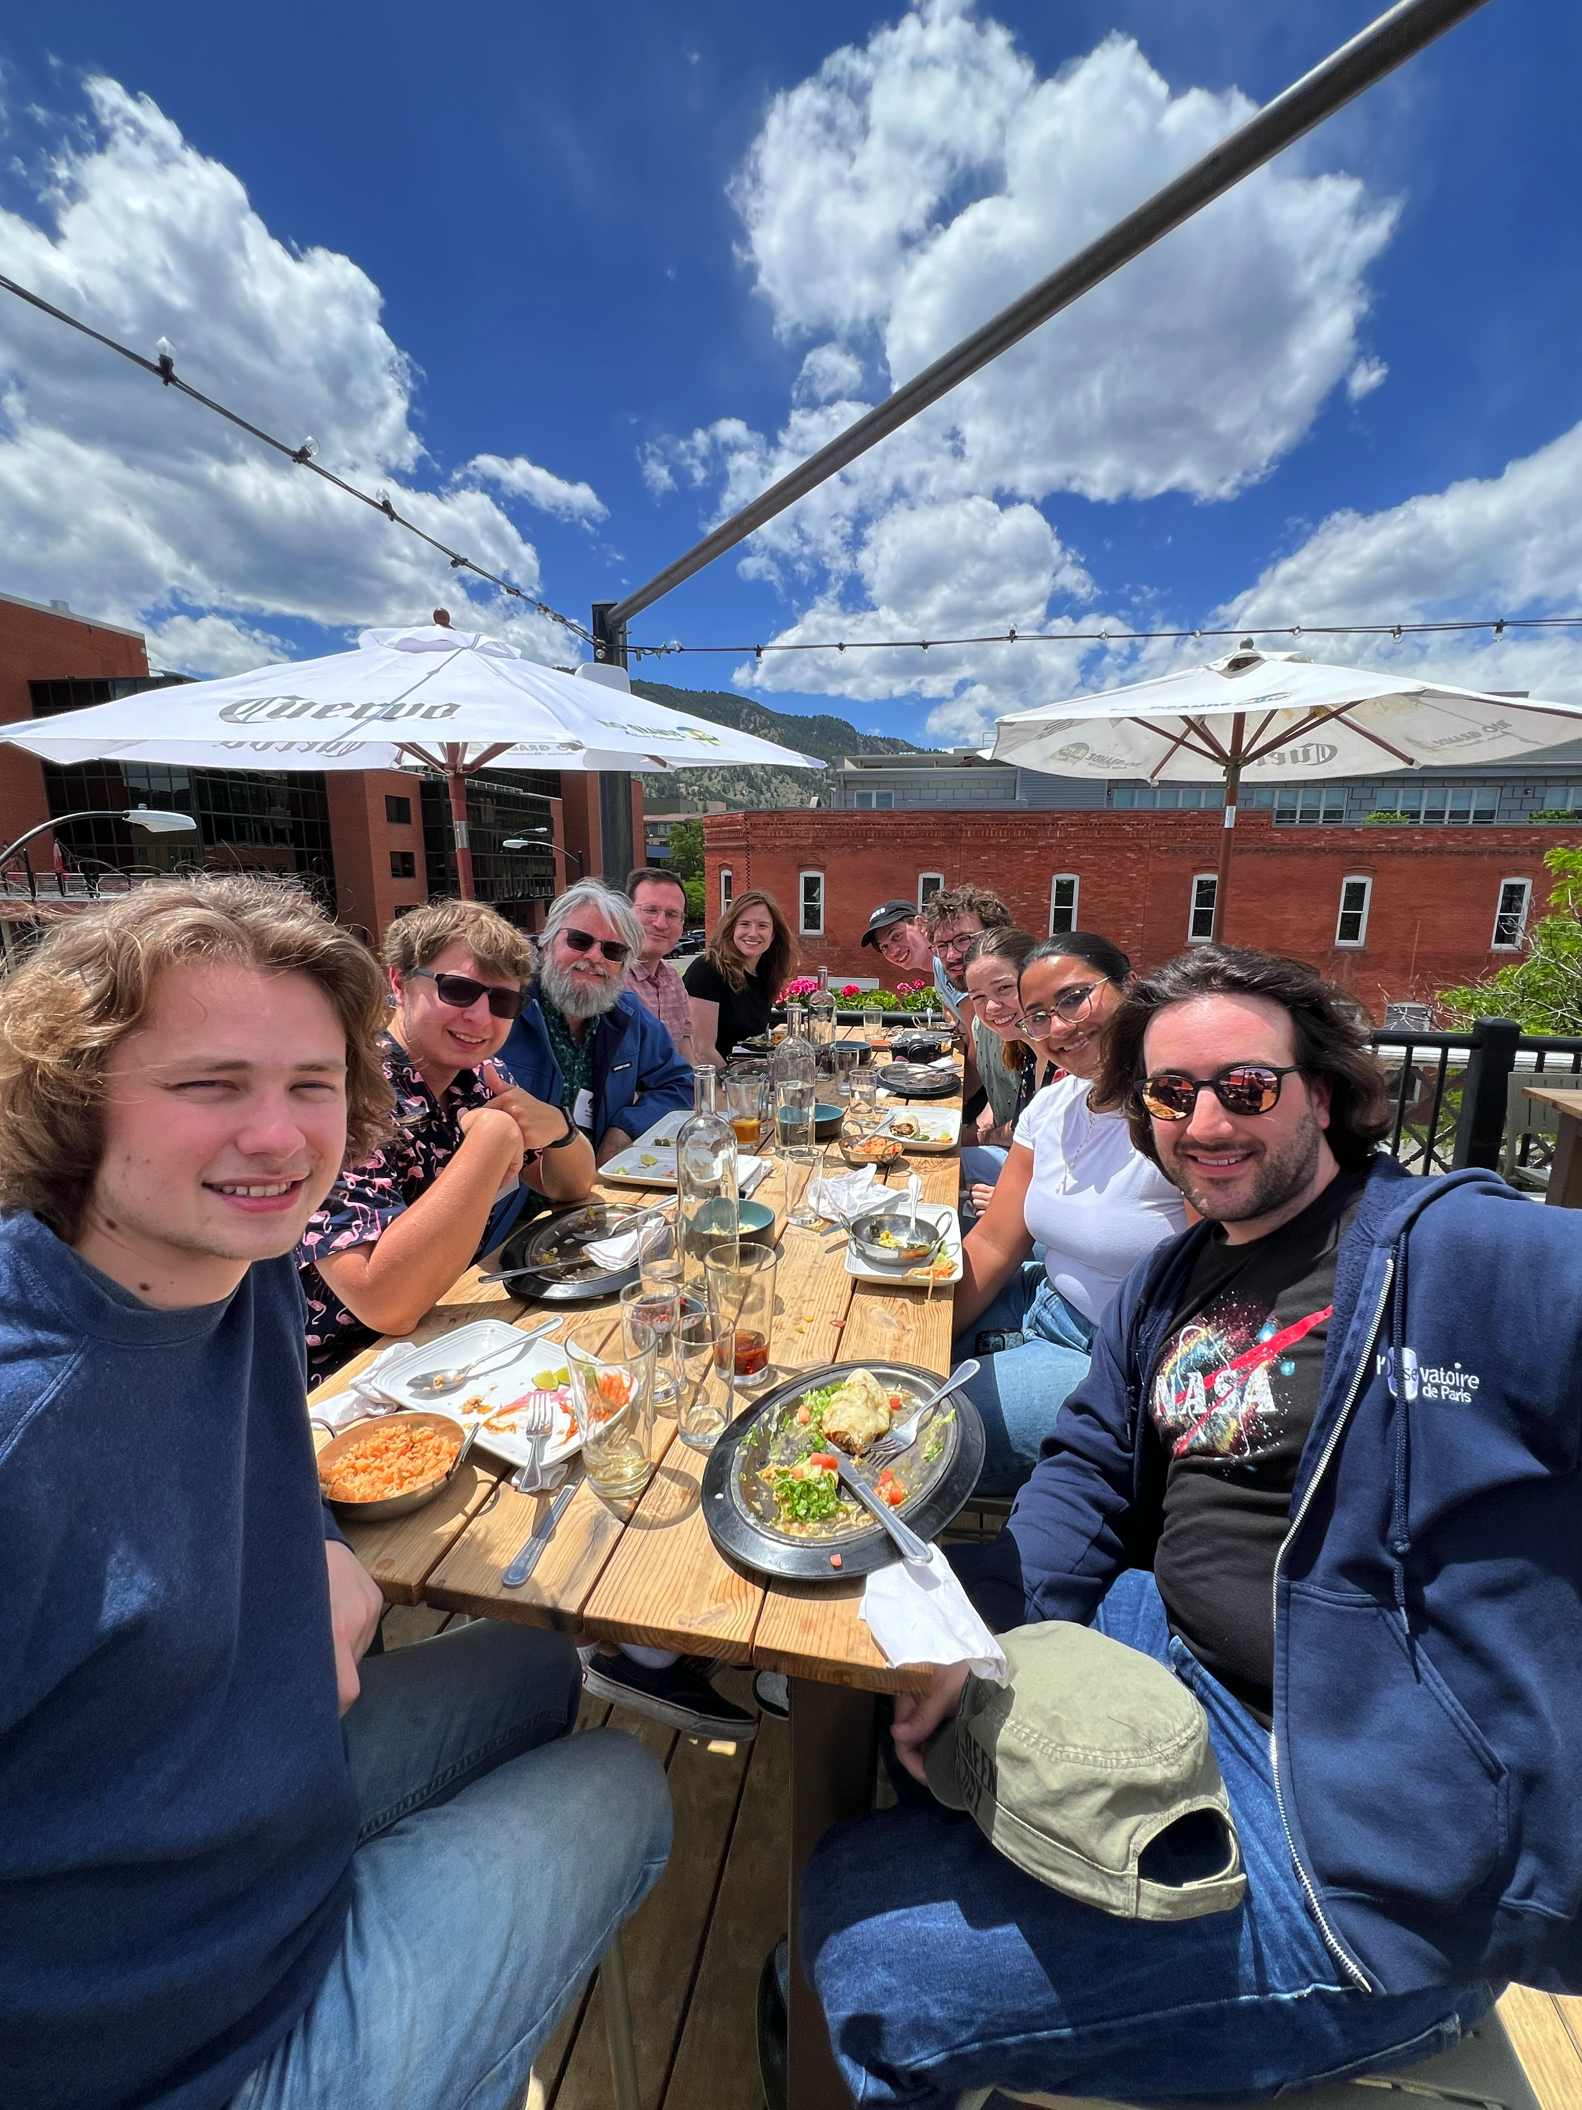
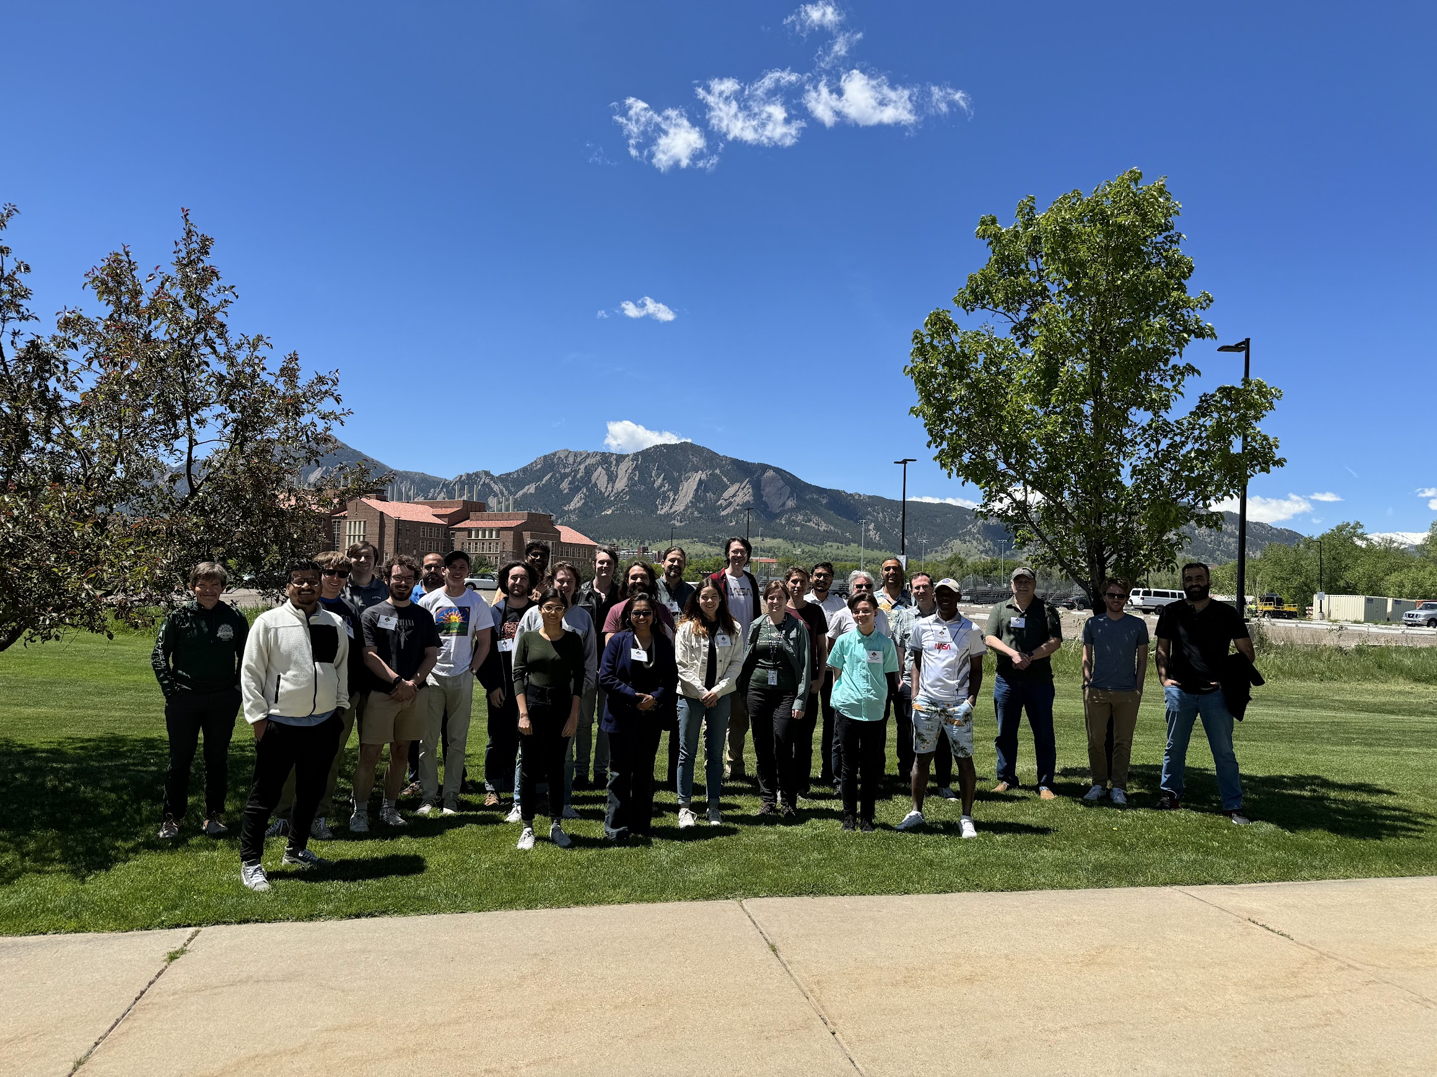
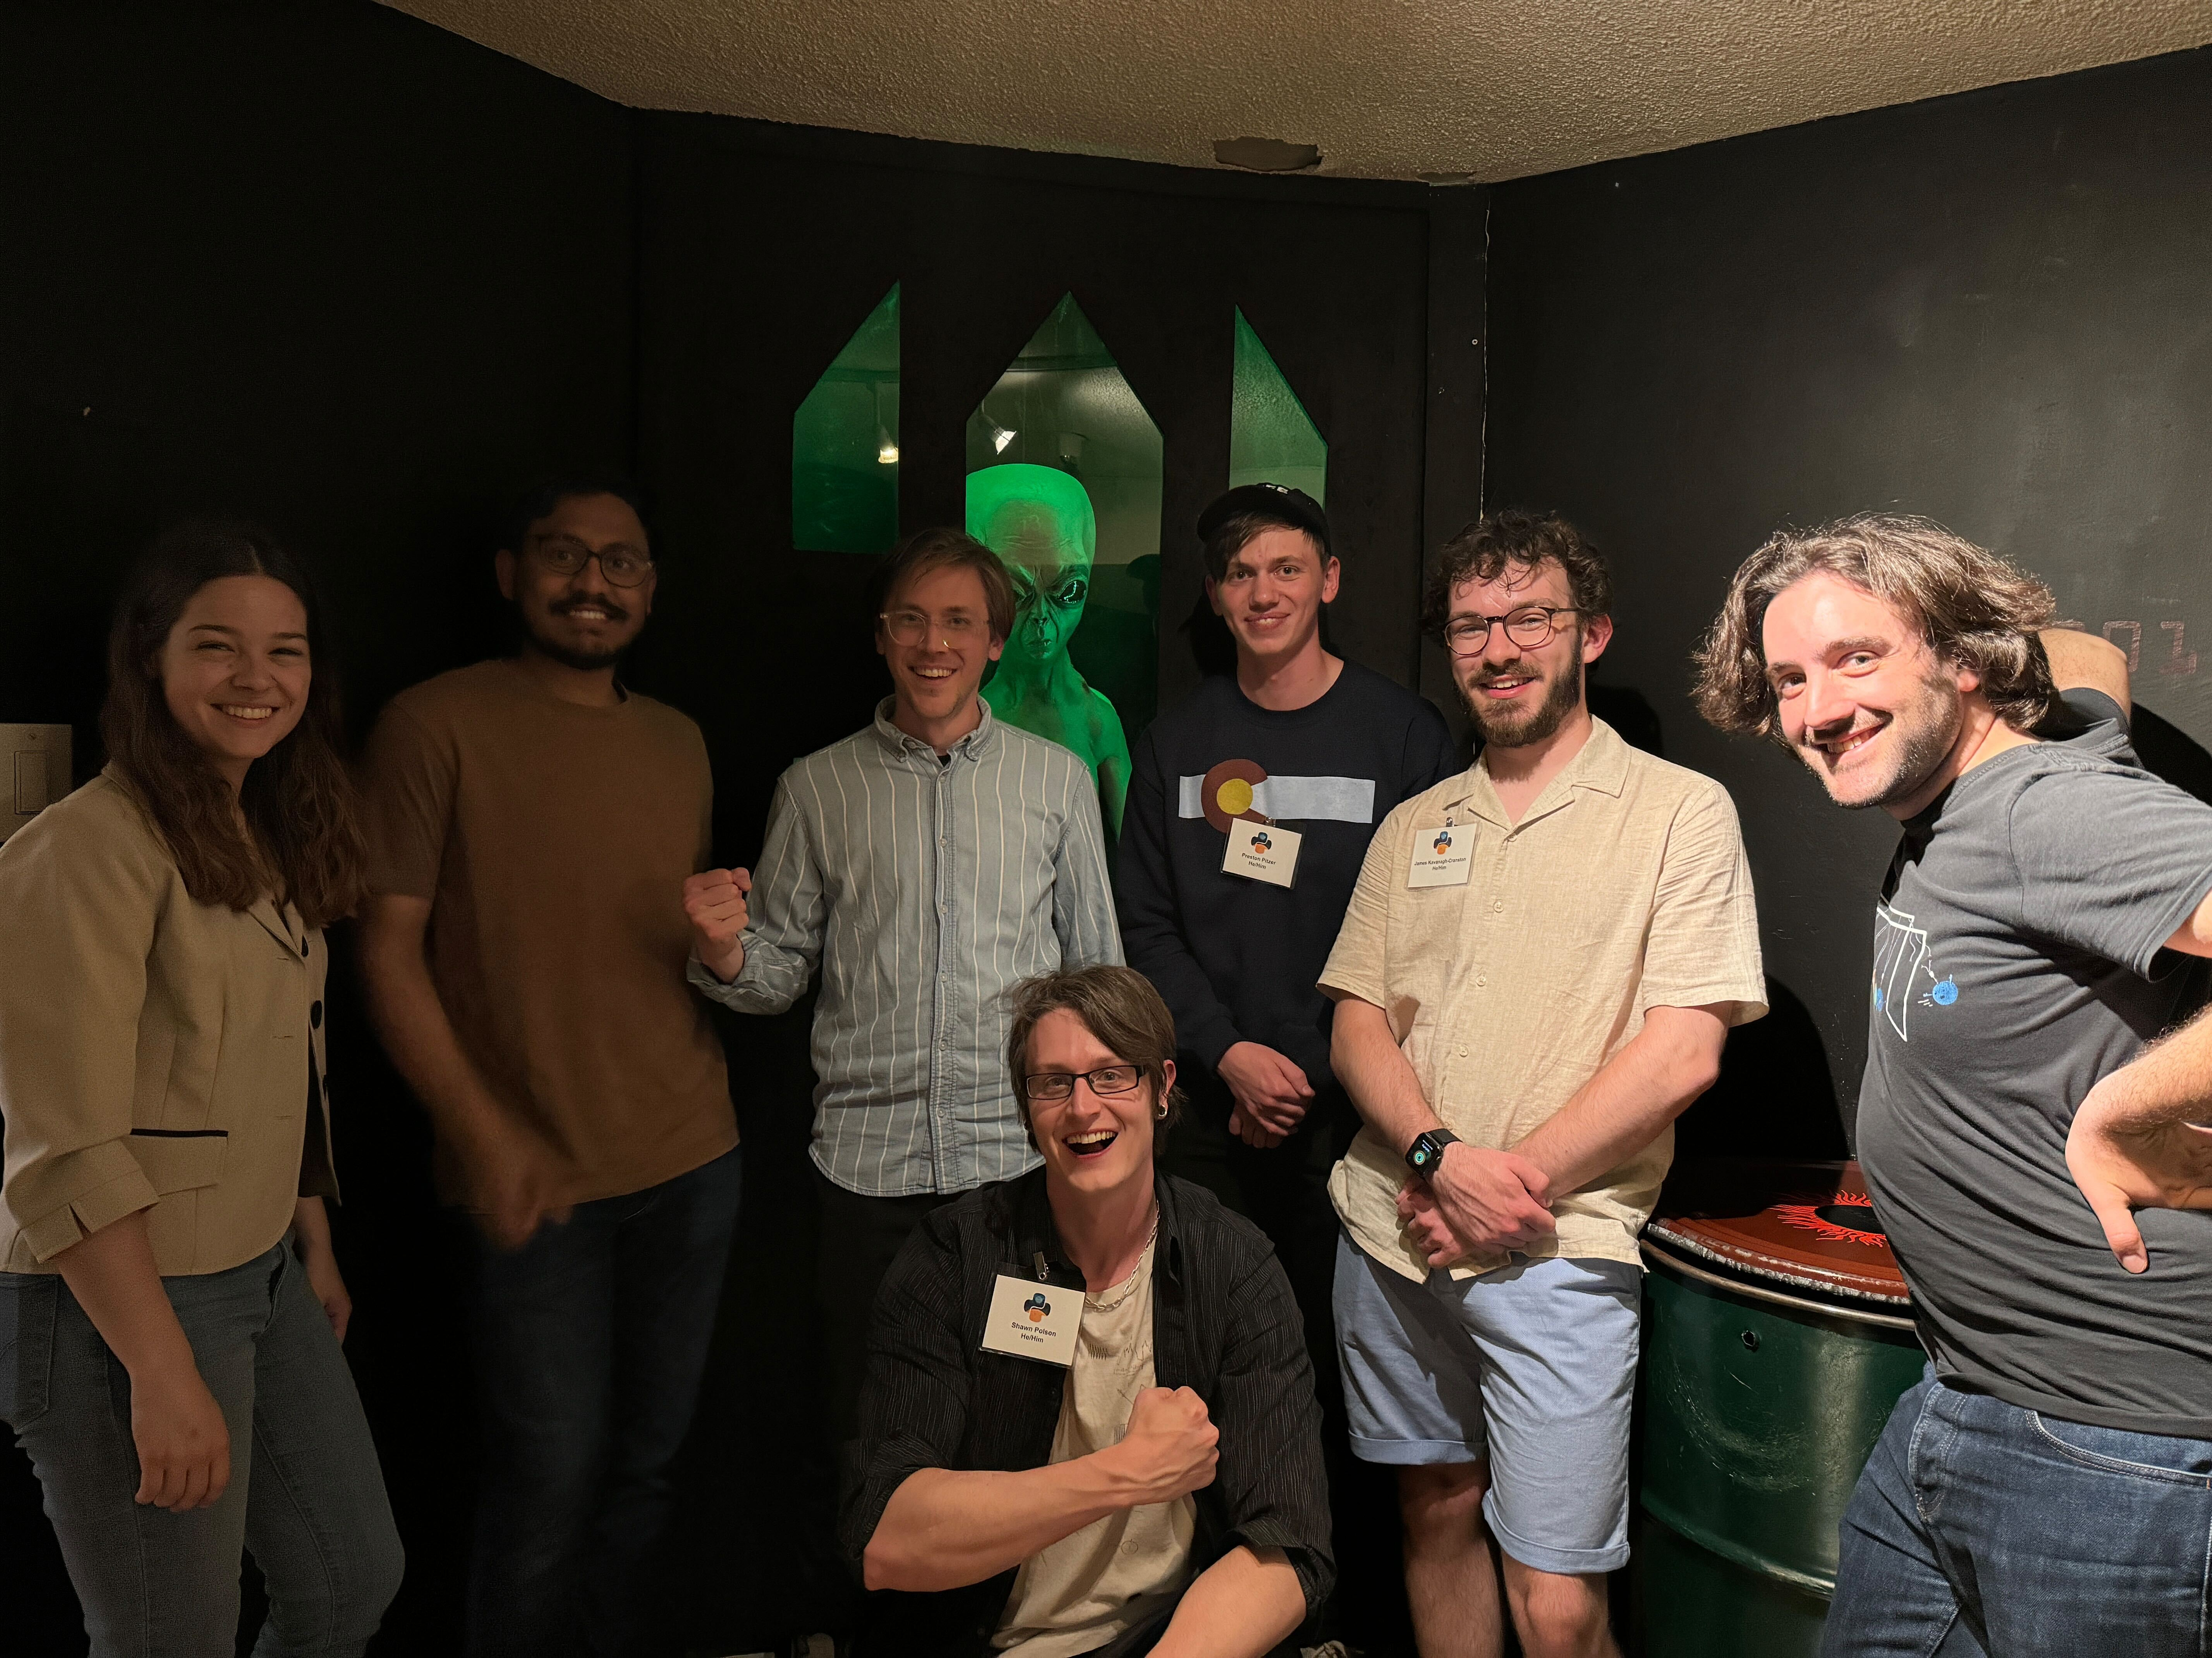
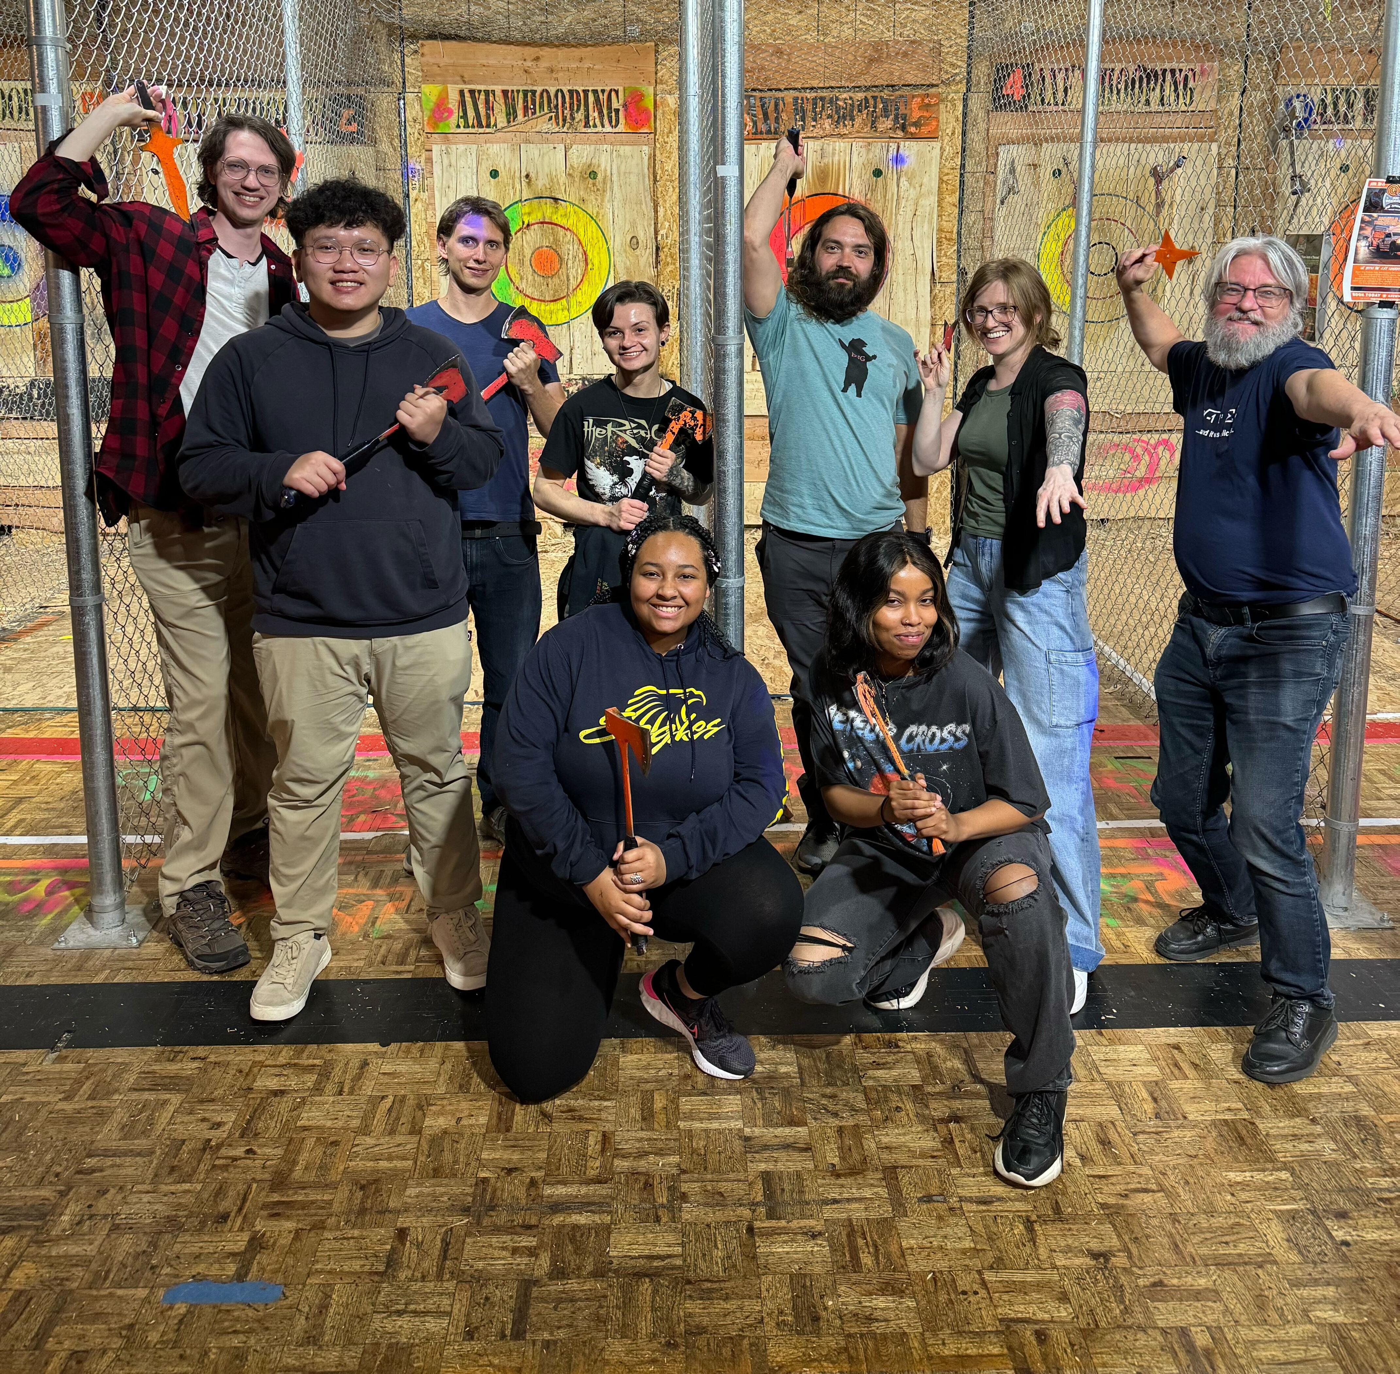
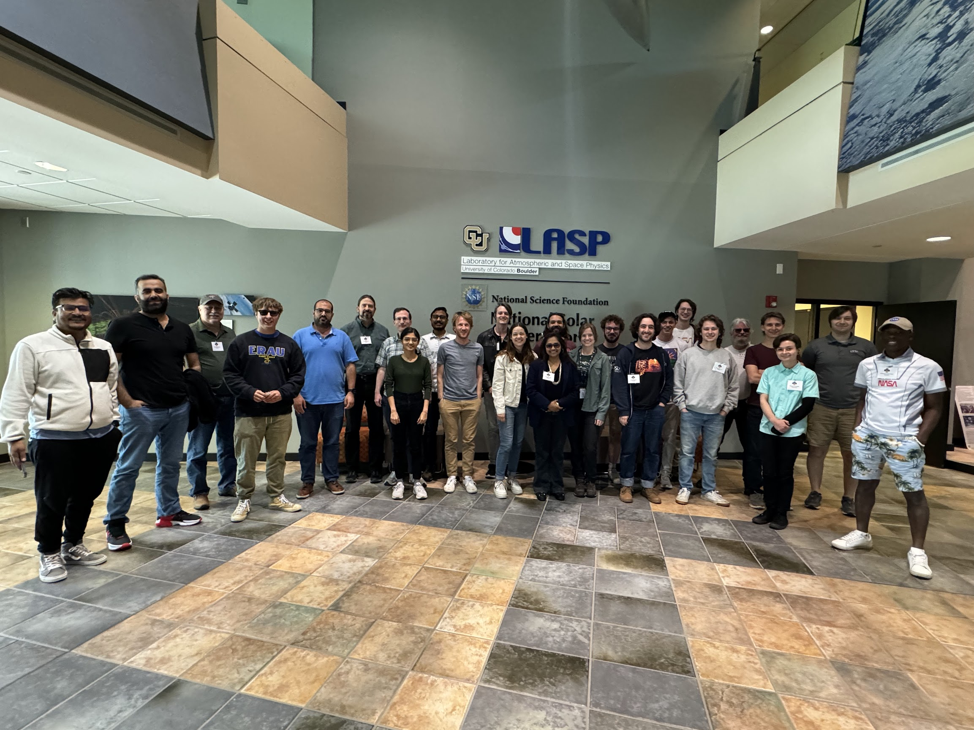
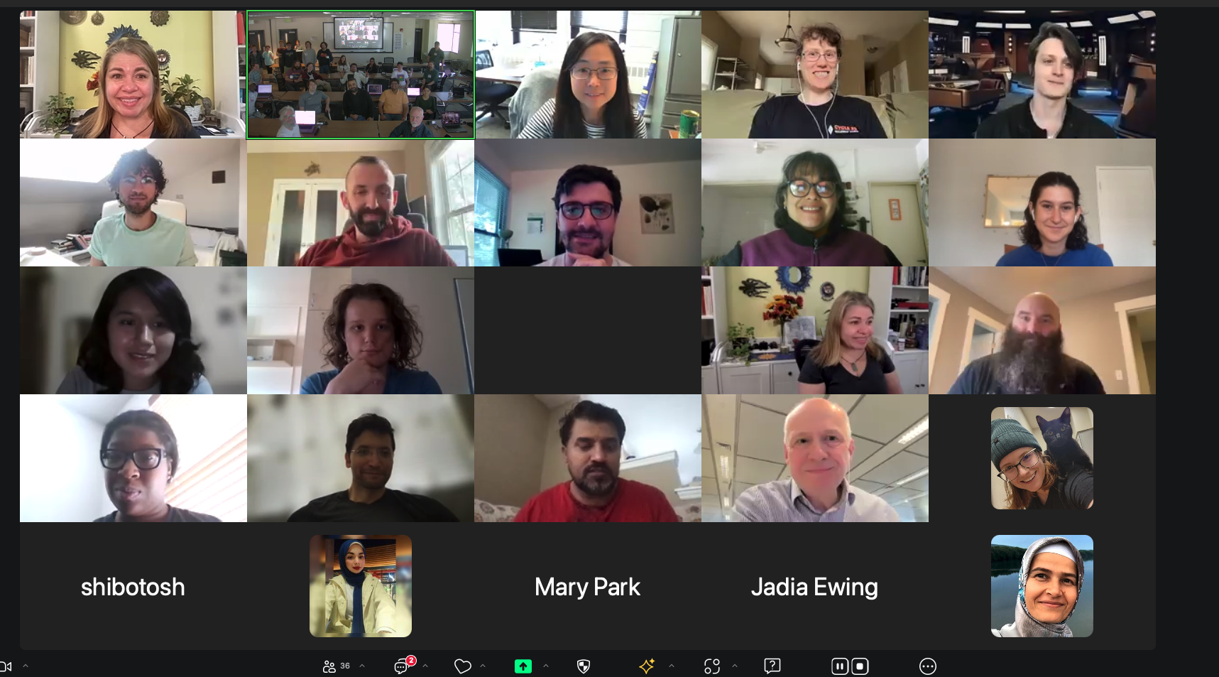
Thank you again! Hope to see you all at future PyHC events. Safe travels home.

